Slide 1
Interpreting with LIME
By Farhan Tariq

Slide 2
Background
3rd year Computer Scientist
Studied Machine Learning and Neural Networks
Dissertation - Sentiment Analysis of Financial News Headlines

Slide 3
Introduction
LIME
Local
Explains instances rather than the whole model
Interpretable
Easy to understand the underlying reasoning
Avoids abstractions (e.g. embeddings) by working with original data
Model-agnostic
Independent of underlying model architecture, applied to any model
Assumes a black box - can easily use and compare
Explanations
Can be used to understand and improve the model
Can be used to explain global model (general behaviour of model, not just one instance)
Notes:
LIME modifies a single data sample by tweaking the feature values and observes the resulting impact on the output
Created by approximating the underlying model locally by an interpretable one

Slide 4
Local surrogate
Also known as local fidelity, local model
Describes how model actually behaves, using a smaller faithful model
Significantly simplifies task
Pick a model interpretable by humans
Line, shallow decision tree, sparse features
Local fidelity approximates global fidelity
But does not necessarily imply global fidelity
Otherwise a global linear model would just be used

Slide 5
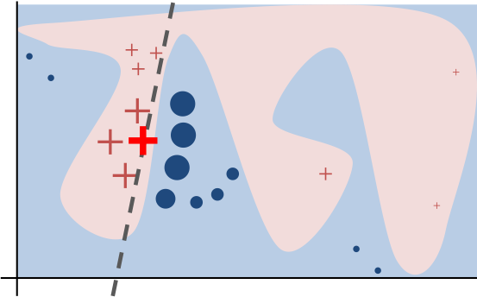
How it works
Sample points around x_{i} (perturb/alter)
Use complex model to predict labels for each sample
Weigh samples according to distance from x_{i} (similarity)
Learn new simple model on weighted samples
Notes:
Multiple classes - can use one vs. one or one vs. rest classifier

Slide 6
Creating perturbed data
Text
Presence/absence of words
Image
Presence/absence of superpixels (contiguous patch of similar pixels)
Tabular data
Weighted combination of columns

Slide 7
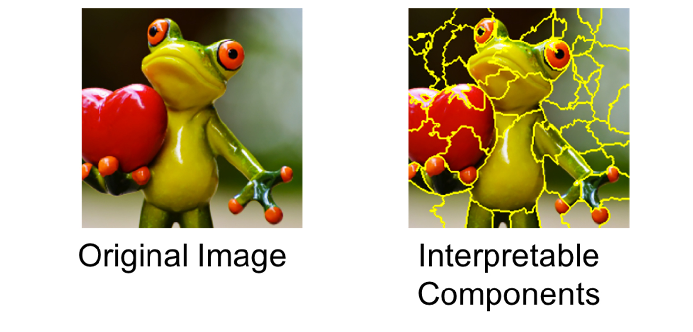
Notes:
Superpixels - interconnected pixels with similar colors and can be turned off by replacing each pixel with a user-defined color such as gray
Can also specify a probability for turning off a superpixel in each permutation

Slide 8
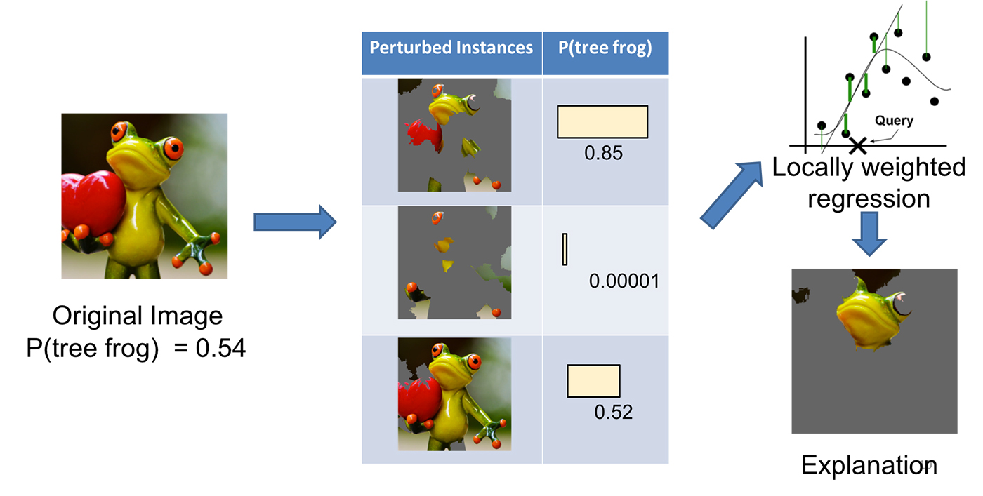
Notes:
Hide certain superpixels to create a dataset
Create interpretable model using local weighted model e.g. regression
In the end, the components with the highest positive probabilities/weights are presented as an explanation.

Slide 9
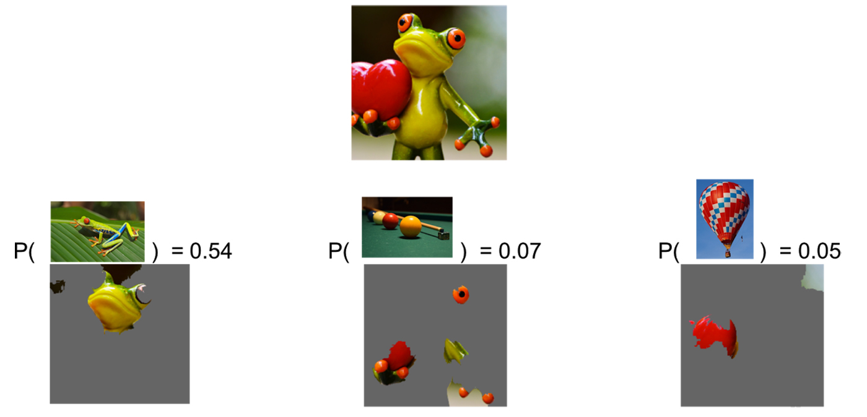
Notes:
LIME probabilities of different classes

Slide 10
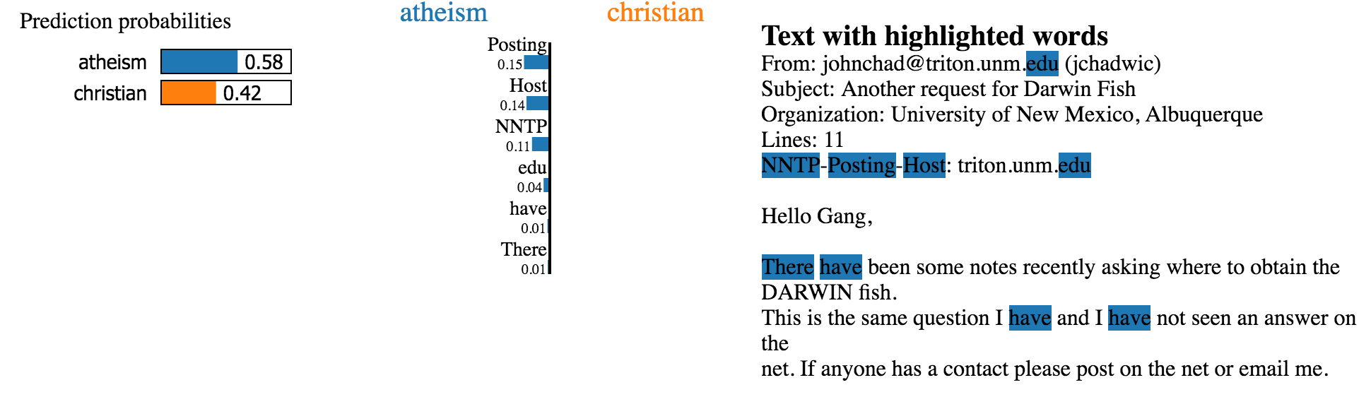
Text inference
92.4% accuracy using random forests
“Posting” appears more than 20% in datasets, 99% in Atheist
Use 6 features to obtain effect of each word on linear classifier
Notes:
92.4% accuracy
“Posting” appears more than 20% in dataset, 99% of which are in “Atheist”
Data should be cleaned!
Model and samples can be cleaned, and removing “Host” and “NNTP” decreases probability of athiesm by roughly the probability of these two features

Slide 11
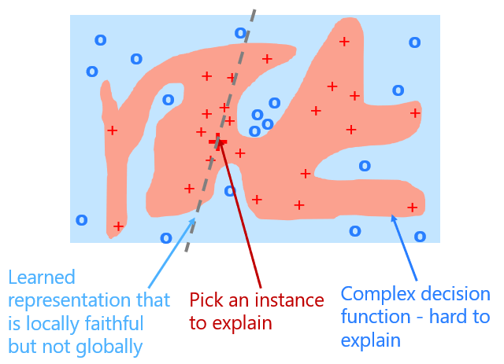
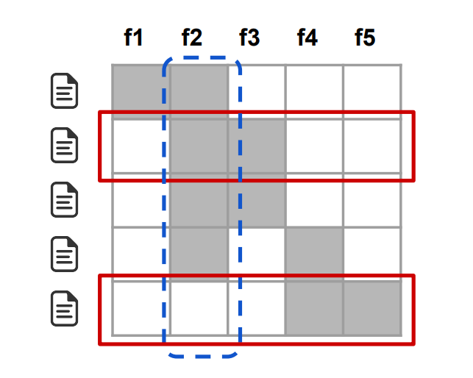
Global surrogate using SP-LIME
Approximate global domain
Use examples representative of various inputs
Cover the global domain as much as possible
We must…
Contain representative examples
Avoid redundancy
Notes:
Feature f2 (dotted blue) has the highest importance.
Rows 2 and 5 (in red) would be selected by the pick procedure, covering all but feature f1
Rows (documents), columns features (words).

Slide 12
LIME advantages
Model-agnostic, easily interpretable and explainable for local instances
Text rather than abstract representations of input e.g. word embeddings
Faster than Shapley Values - much less computationally expensive
Works for tabular data, text and images
Only requires model, not original data

Slide 13
LIME disadvantages
Limited by linearity - only linear models are used to approximate local behaviour
Instability
Explanations of two very close points can vary greatly in a simulated setting
Not exhaustive - must cover global domain to fully understand model
Currently no support for regression, video, audio
Perturbed instances may be difficult
Sepia, grayscale

Slide 14
Conclusion
Local surrogate models, with LIME as a concrete implementation, are very promising
But is not the ultimate solution
Still more work needed to tackle disadvantages

Slide 15
Further resources
Original paper
https://arxiv.org/pdf/1602.04938.pdf
GitHub
https://github.com/marcotcr/lime
Talks
https://www.youtube.com/watch?v=KP7-JtFMLo4
https://www.youtube.com/watch?v=CY3t11vuuOM
Blog posts
https://www.oreilly.com/content/introduction-to-local-interpretable-model-agnostic-explanations-lime/
https://christophm.github.io/interpretable-ml-book/lime.html
https://towardsdatascience.com/understanding-model-predictions-with-lime-a582fdff3a3b
https://www.twosigma.com/insights/article/interpretability-methods-in-machine-learning-a-brief-survey/

Slide 16
Questions?

Slide 17
Thank you!

Slide 18
Additional information

Slide 19
Why interpret?
Correctness
Noise
Overfitting
Correlations
Accuracy
Inference
Trust - for developers and users, drawing on model ‘attention’ and features used
Predict - medicine, crime, recommendations etc.
Improve - data, tuning, architectures, compare to other models
Legal
GDPR - Right to explanation
Discrimination and ‘Weapons of Math Destruction’
Prisoner parole, granting loans
Targeted advertising
Vulnerable people
Notes:
Can be working correctly for the wrong reasons
Cathy O’Neil - big data algorithms are increasingly used in ways that reinforce pre-existing inequality
Insurance, advertising, education, and policing, can lead to decisions that harm the poor, reinforce racism, and amplify inequality - poverty cycle
Opaque, unregulated, difficult to contest, and scalable

Slide 20
Current options
Interpretable models - decision tree, linear regression
Often trade interpretability for accuracy
Accuracy and cross-validation
A/B testing - comparing between different models
Tuning and optimisation

Slide 21
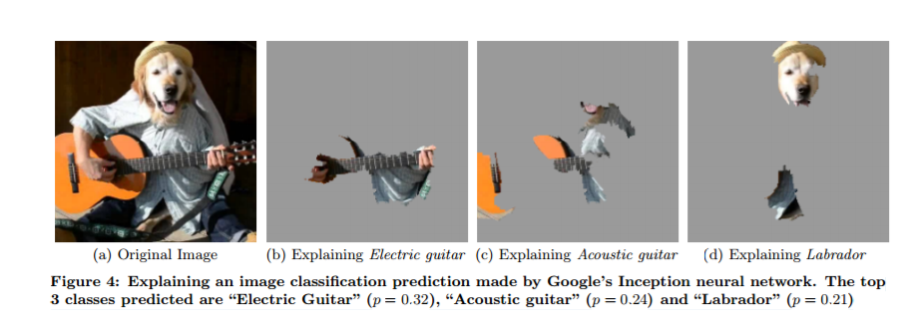
Notes:
Can still trust model if inferences are correctly drawn

Slide 22
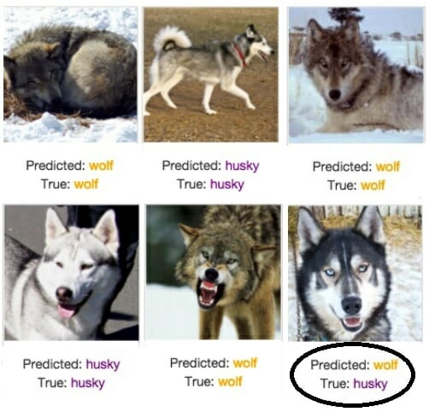
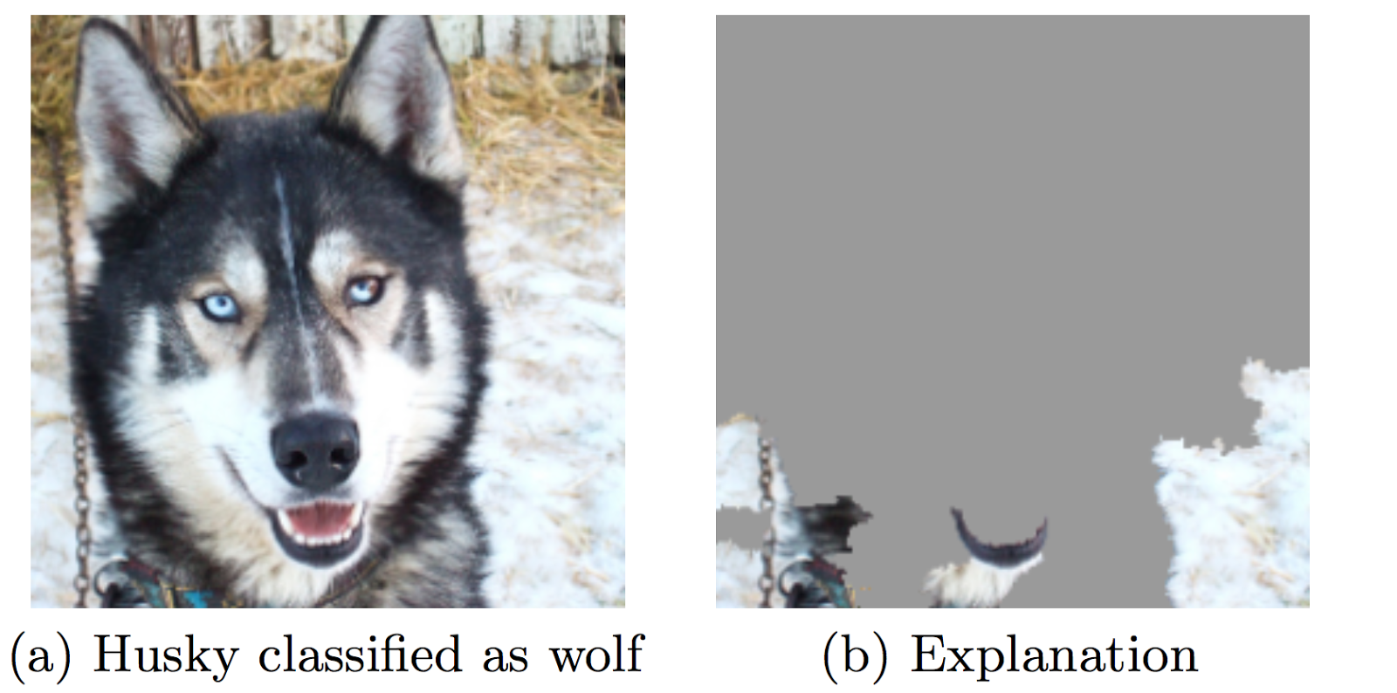
Image inference

